Slide 1


SMART INDIA HACKATHON 2024
TITLE PAGE
Problem Statement ID –1642
Problem Statement Title - AYUSH Startup Registration Portal for Streamlined and Accessible Registration Process
Theme-MedTech / BioTech / HealthTech
PS Category- Software
Team ID-
Team Name -Kodecrafts

Slide 2
IDEA TITLE
KODECRAFTS
Idea/Solution
A secure, user-friendly portal designed to streamline the registration process for startups in the AYUSH sector.
Portal includes the following features:-
User Authentication: Secure login with multi-factor authentication for Startups, Officials, Stakeholders.
Application Status Tracking: Transparent, real-time updates with automatic notifications.
Personalized Dashboards: Provide startups, stakeholders, and government officials with tailored insights and progress tracking. Each user type gets customized views and data relevant to their roles and needs.
Data Management: Centralized, encrypted data handling with audit trails.
Support & Resources: Centralized FAQs, resources, real-time support, and a chatbot for instant assistance.
Stakeholder-Startup Chat: Secure, real-time messaging with history, and direct video calls, facilitating seamless collaboration between founders and stakeholders.
Use secure cloud storage with backup and replication to prevent data loss.
How Our Portal Solves Existing Problems:
Streamlined Registration: Simplifies registration by centralizing processes, enhancing information access, and enabling real-time status tracking.
Enhanced Communication and Support: Solves delays and inefficiencies with direct, secure messaging between stakeholders and founders, and ensuring better collaboration
Uniqueness of the solution
Integrated Communication and Chat: Combines secure messaging and real-time chat for seamless interactions between stakeholders and founders.
Offers personalized dashboards, ensuring efficient registration and tailored user experience.

Slide 3
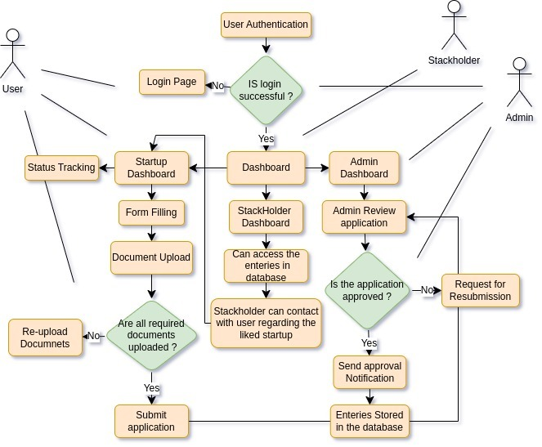
TECHNICAL APPROACH
KODECRAFTS
Frontend (User Interface and Experience):
React/Angular: Used for creating dynamic, personalized dashboards and interfaces.
Backend (Server-Side Logic & APIs):
Node.js with Express: Manages the backend, providing real-time updates and secure server operations.
Database:
MongoDB: Handles secure data storage with AES-256 encryption and audit trails.
Real-Time Communication:
WebSocket/SSE: Enables real-time messaging using libraries like socket.io and status tracking.
Security:
OAuth 2.0, JWT, MFA: Ensures secure authentication and access control.
.TOTP: for two factor authentication(2FA) that generates one time password (OTP).
Collaborations:
WebRTC: Facilitates Collaboration via video call using libraries like PeerJS.
Support & Resources:
Tawk : Facilitates real-time support via chats.
Flowchart

Slide 4
FEASIBILITY AND VIABILITY
KODECRAFTS
Feasiblity of the idea:
Technical Feasibility:
Cloud Integration: Secure, scalable cloud infrastructure supports high registration volumes.
Real-time Updates: WebSocket enables instant communication and status tracking.
Operational Feasibility:
User-Centric: Personalized dashboards enhance user experience across stakeholders.
Centralized Resources: Efficient support through centralized FAQs and real-time chatbot.
Economic Feasibility:
Cost-Efficient: Open-source tech reduces development costs;
Regulatory Feasibility:
Compliance: Encryption and audit trails ensure data protection and regulatory adherence.
Transparency: Real-time tracking aligns with government transparency goals.
Scalability:
High Volume Handling: Scalable design accommodates sector growth and future needs.
Challenges | Mitigation
1.Managing and securing large volumes of startup data as the sector grows rapidly. | Use MongoDB's sharding for scalable data management with regular backups for security.
2.Protecting sensitive data from potential cyber threats and breaches | Employ multi-layered security protocols, regular audits, and real-time monitoring to detect and respond to threats.

Slide 5
IMPACT AND BENEFITS
KODECRAFTS
Impact on target audience​
Benefits of the startup registration portal
1. Increased Entrepreneurship
Streamlined Registration: Lowers entry barriers, boosting entrepreneurship in AYUSH, leading to job creation, economic growth, and the promotion of traditional health practices.
2. Boost in Innovation and Growth
Supportive Environment: Provides real-time support and resources, accelerating innovation and growth, and enhancing public health through new products and services.
3. Enhanced Compliance and Transparency
Automated Processes: By automating and making the registration process transparent, the portal ensures startups adhere to regulatory standards effortlessly. This promotes ethical business practices and trust within the industry, leading to a more regulated and transparent market that benefits both consumers and businesses.
1.Resource Optimization
Efficient Operations: Provides tailored dashboards, real-time support, and resources, optimizing the startup process and reducing time and effort.
2.Enhanced Collaboration
Stakeholder Engagement: Facilitates secure communication between startups and stakeholders, leading to better decision-making and stronger partnerships.
3.Increased Entrepreneurial Activity
Growth and Innovation: Encourages more startups, driving innovation and contributing to economic development in the health and wellness industry.

Slide 6
RESEARCH AND REFERENCES
KODECRAFTS
Email authentication support Docs
Dropzone for File Drag and drop functionality Docs
JWT for token based authentication Docs
TAWK for Real time chat support Docs
Video call collaboration using webRTC Docs with PeerJS Docs
Websockets and Socket.io for chats Docs

